Slide 1
Module 9.1 - Mapping
Introduction to Mapping

Slide 2
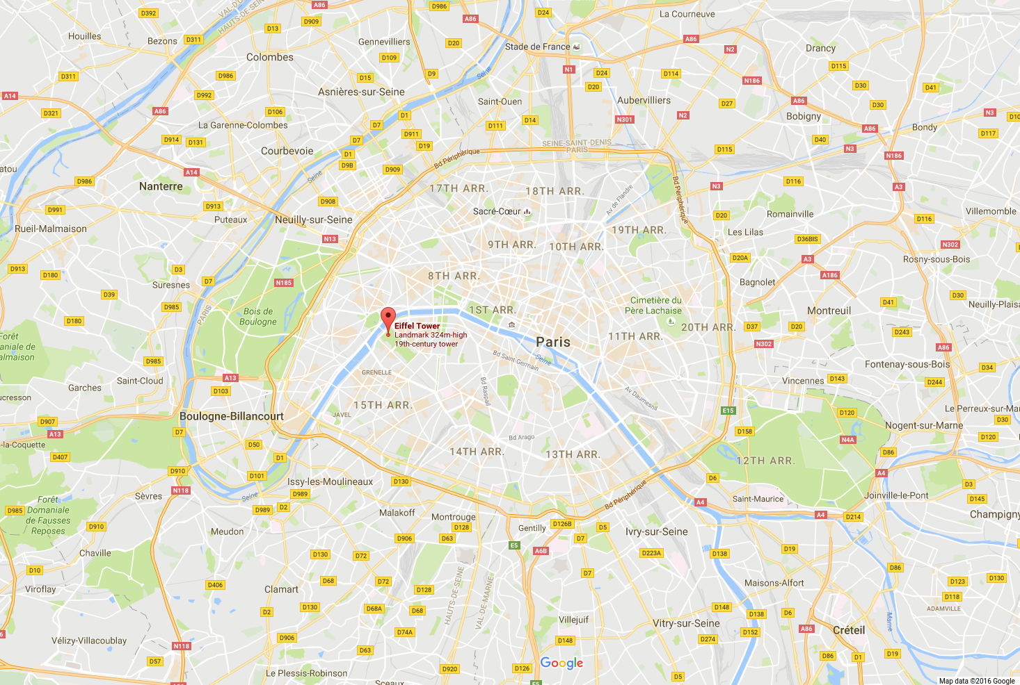
Mapping in Robotics
Maps are essential for robots to devise plans for navigating
Robots use maps to avoid obstacles and find shortest paths
Often robots update their own maps as they explore and learn
Notes:
Robots can use maps for planning, but maps can also be used by external parties to instruct fleets of robots on how to navigate
It is imperative that robots do not rely solely on maps because most environments are dynamic and the map may not perfectly reflect the environment.

Slide 3
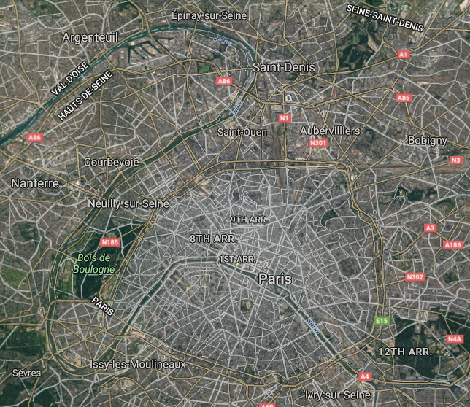
Aerial Maps
A top-down view of an environment provides useful information that may be impossible to gather by a ground robot
Sources of aerial maps
satellites
drones
planes
Notes:
Aerial maps are the most common type of map used by humans for navigation.
Common tools for navigating like TomTom, Google Maps, and Bing Maps all use aerial data from planes and satellites
Satellite maps are usually only useful to an accuracy of a couple meters, so local maps and sensors are used for avoiding small obstacles and local planning.

Slide 4
Map Stitching
Discrete images must be combined to create a map
Image stitching is the process of joining overlapping images
Image Stitching pipeline:
define relationship between coordinate systems in images
determine alignment (and orientation) of images with each other
detect features (keypoints) in images
match features in each image with other images to show how images overlap
output the stitched image by projecting it onto a surface (plane, cylinder, sphere, etc)
Notes:
Image stitching is used to create panoramas, stabilize videos, and produce mosaics
Aerial photos may be taken at different times of day with different camera settings, so the task of matching and stitching together the images can be challenging.
Oftentimes the images can be rotated or scaled differently.

Slide 5
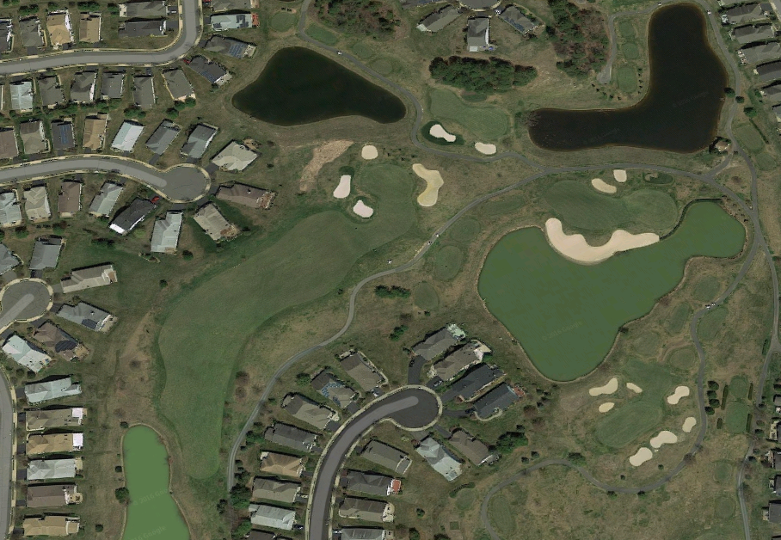
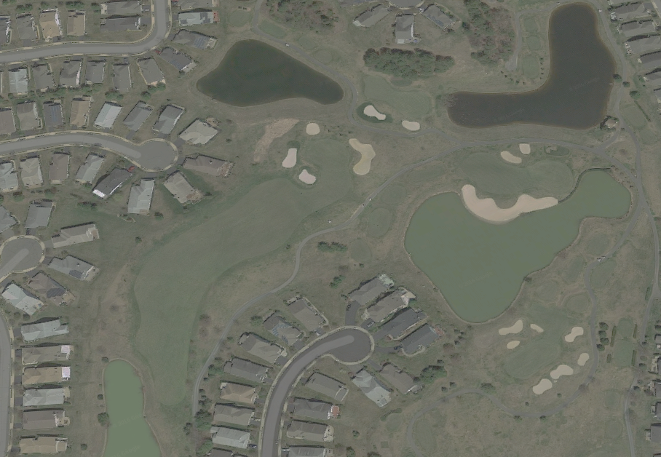
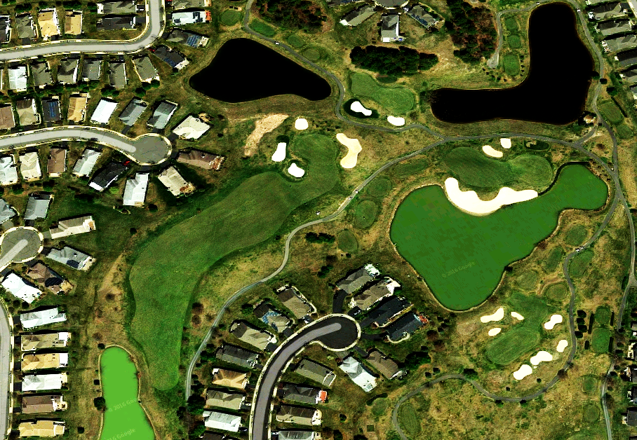
Map Stitching: Example
Notes:
Raw images may be rotated, scaled, and colored differently
The first step is aligning these photos and normalizing the coloring differences as much as possible.

Slide 6
Map Stitching: Example
Notes:
The dots are a subset of the features extracted from the images
Notice that the images are scaled differently; robust image stitching algorithms can compensate for changes in scale

Slide 7
Map Stitching: Example

Slide 8
Image Stitching with OpenCV
Image stitching is dramatically faster on GPUs, so the code below operates on GPU matrices.
The `Stitcher` class in OpenCV has many configuration options that can refine the results and potentially improve performance
std::vector<gpu::GpuMat> gpuImages(3);
gpu::GpuMat stitch_result;
cv::Stitcher stitcher = cv::Stitcher::createDefault(true);
cv::Stitcher::Status status = stitcher.composePanorama(gpuImages, stitch_result);
Notes:
It is best to only stitch a few images together at a time to reduce the time required
Use information about when and where the photos were taken so that only images that you know overlap are combined in the stitching process
Images can be uploaded to the GPU with `gpuImages.upload(cpu_matrix)’ and downloaded with `stitch_result.download(cpu_matrix)`

Slide 9
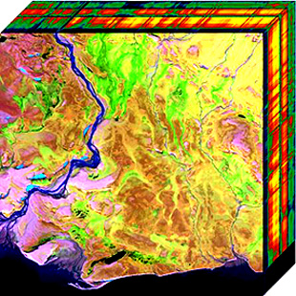
Multi-Layer Maps
Maps can contain additional information:
semantic information (place names and descriptions)
timely information like traffic conditions or road closures
hyperspectral images that capture non-visible light
thermal images for detecting animals
GIS (Geographical Information Systems) are used to analyze maps with many layers of data
Notes:
Robots should utilize all available information in their maps when it is relevant
Semantic information is especially important for robots that must deliver packages or interact with objects based on their human-understandable names
Timely information can be essential for helping robots make real-time decisions
Hyperspectral images are used in surveying crops and help direct robots identify the water content and vegetation in an area
Thermal images show humans and warm-blooded animals; drones in National Parks in Africa use thermal images to catch illicit poachers.

Slide 10
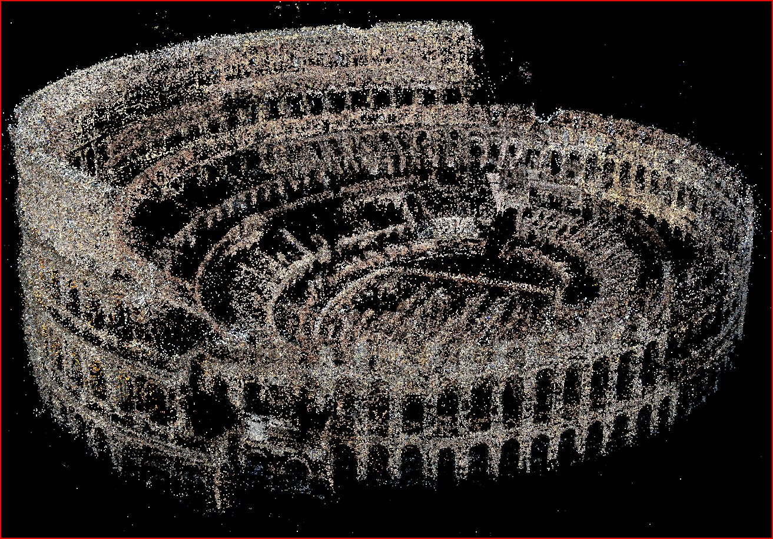
Point Clouds
Point Clouds or a set of coordinate with x,y,z values
Sometimes points will also have color data associated with them.
http://grail.cs.washington.edu/rome/dense.html
Notes:
Point clouds are one of the most common ways of building maps for robotics.
Dense point clouds provide more information but they can require more computing power to process
Point clouds can be used to render 3D mesh models that require less space to store and are easier for robots to navigate around.

Slide 11
Generating Point Clouds
Stereo Cameras
LiDAR
Radar
Structure From Motion
Image Alignment and Stitching
Notes:
Point clouds can be produced by a number of different sensors and techniques
Stereo cameras use two overlapping camera views to reconstruct depth data to produce point clouds
LiDAR and radar produce high density point clouds by capturing depth data continuously.
Even a monocular camera can be used to gather depth information by moving the camera and running algorithms that use the motion information to combine the images into depth information
A large number of independent images can be combined to estimate depth and produce point clouds (like the coliseum in the previous slide).

Slide 12
The GPU Teaching Kit is licensed by NVIDIA and California Polytechnic State University under the Creative Commons Attribution-NonCommercial 4.0 International License.

